Slide 1
Chapter 1 Data Warehousing, Business Intelligence, and Dimensional Modeling Primer

Slide 2
Different Worlds of Data Capture and Data Analysis
One of the most important assets of any organization is its data or information.
This asset is primarily used for two purposes:
Operational record keeping. With the operational systems, we capture data. These systems are optimized to process transactions quickly, typically one transaction record at a time. These systems typically do not maintain history, but rather update data to reﬂect the most current state.
Analytical decision making. With the data warehousing and business intelligence (DW/BI) systems, we read and analyze the data. These systems are optimized for high-performance queries as users’ questions often require that many transactions be searched and compressed into an answer set. Users of a DW/BI system typically demand that historical context be preserved to accurately evaluate the organization’s performance over time.

Slide 3
Goals of Data Warehousing and Business Intelligence Systems
Make information easily accessible. The data must be intuitive and obvious to the business user. The system must return query results to the user with minimal wait times.
Present information consistently. If two performance measures have the same name, they must mean the same thing. Data must be carefully assembled from a variety of sources, cleansed, quality assured, and released only when it is ﬁt for user consumption.
Adapt to change. User needs, business conditions, data, and technology are all subject to change. The system must be able to handle this change gracefully.
Serve as the authoritative and trustworthy foundation for improved decision making.
Be accepted by the business community (users).

Slide 4
Dimensional Modeling Introduction
Dimensional Modeling is a design technique for databases intended to support end-user queries in a data warehouse. It is oriented around understandability and fast query performance.
Consider this business oriented statement: “We sell products in various markets and measure our performance over time.”
It is intuitive to think of such a business as a cube of data, with the edges labeled product, market, and time. Points inside the cube are where the measurements, such as sales volume or proﬁt, for that combination of product, market, and time are stored.

Slide 5
Dimensional Modeling Introduction (continued)
Dimensional models are often instantiated in relational database management systems; but, they are quite different from third normal form (3NF) models that seek to remove data redundancies.
A dimensional model contains the same information as a normalized model, but packages the data in a format that delivers user understandability and query performance.

Slide 6
Star Schemas Versus OLAP Cubes
Dimensional models implemented in relational database management systems are referred to as star schemas because of their resemblance to a star-like structure (see the figure on the next slide).
Dimensional models implemented in multidimensional database environments are referred to as online analytical processing (OLAP) cubes (see the figure on the next slide).
Typically, detailed, atomic information are loaded into a star schema; optional OLAP cubes are then populated from the star schema.
When data is loaded into an OLAP cube, it is stored and indexed using formats and techniques that are designed for dimensional data.
Performance aggregations or pre-calculated summary tables are often created and managed by the OLAP cube engine. Consequently, cubes deliver superior query performance because of the pre-calculations, indexing strategies, and other optimizations.

Slide 7
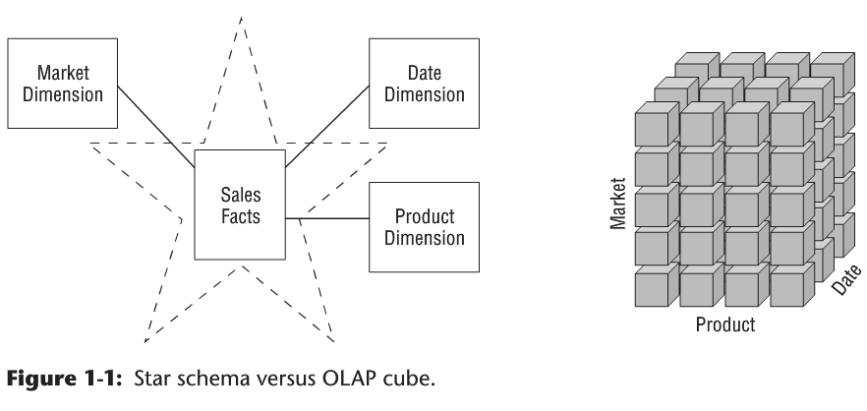
Star Schemas Versus OLAP Cubes (continued)

Slide 8
Fact Tables for Measurements
The term fact represents a business measure. The fact table in a dimensional model stores the performance measurements resulting from an organization’s business process events. The most useful facts are numeric and additive, such as dollar sales amount and total units sold.
Each row in a fact table corresponds to a measurement event. The data on each row is at a speciﬁc level of detail, referred to as the grain, such as one row per product sold on a sales transaction.
One of the core tenets of dimensional modeling is that all the measurement rows in a fact table must be at the same grain. This ensures that measurements are not double-counted.
The idea that a measurement event in the physical world has a one-to-one relationship to a single row in the corresponding fact table is a bedrock principle for dimensional modeling.

Slide 9
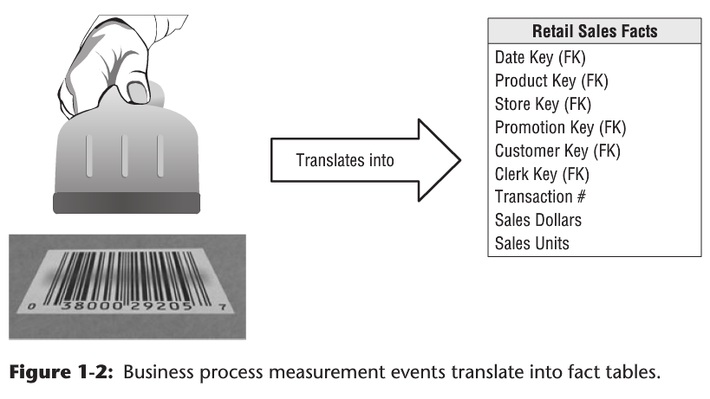
Fact Tables for Measurements (continued)

Slide 10
Fact Tables for Measurements (continued)
Fact’s additivity is crucial because BI applications rarely retrieve a single fact table row. Rather, they read hundreds, thousands, or even millions of fact rows at a time, and the most useful thing to do with so many rows is to add them up.
Facts are sometimes semi-additive or even non-additive. Semi-additive facts, such as account balances, cannot be summed across the time dimension. Non-additive facts, such as unit prices, can never be added. You are forced to use counts and averages or are reduced to printing out the fact rows one at a time—an impractical exercise with a million-row fact table.
Facts are often continuously valued. For example, the dollar sales amount fact is continuously valued because it can take on virtually any positive value.

Slide 11
Fact Tables for Measurements (continued)
It is possible for a measured fact to be textual; however, the condition rarely arises. A textual measurement is a description of something and is drawn from a discrete list of values.
A true text fact is rare because the unpredictable content of a text fact, like a freeform text comment, makes it difficult to analyze.
We should not store redundant textual information in fact tables. Unless the text is unique for every row in the fact table, it belongs in the dimension table, which will be described later.
Fact tables tend to be deep in terms of the number of rows, but narrow in terms of the number of columns.
Fact tables usually make up 90 percent or more of the total space consumed by a dimensional model.
Do not ﬁll the fact table with zeros to represent no activity. These zeros would overwhelm most fact tables. By including only true activity, fact tables tend to be quite sparse.

Slide 12
Fact Tables for Measurements (continued)
All fact table grains fall into one of three categories: transaction, periodic snapshot, and accumulating snapshot. Transaction grain fact tables are the most common.
All fact tables have two or more foreign keys that reference the dimension tables’ primary keys. For example, the product key in the fact table always matches a speciﬁc product key in the product dimension table.
The fact table generally has its own primary key composed of a subset of the foreign keys. In dimensional modeling, every table that has a composite key is a fact table. Fact tables express many-to-many relationships. All others are dimension tables.

Slide 13
Dimension Tables for Descriptive Context
The dimension tables contain the textual context associated with a business process measurement event. They describe the “who, what, where, when, how, and why” associated with the event. Dimension tables are integral companions to a fact table.
Dimension tables tend to have fewer rows than fact tables, but can be wide with many text columns. Each dimension table has a single column primary key.
Dimension attributes serve as the primary source of query constraints, groupings, and report labels. In a query or report request, attributes are identiﬁed as the by words. For example, when a user wants to see dollar sales by brand, brand must be available as a dimension attribute.
Attribute values should consist of real, verbose words rather than cryptic abbreviations.

Slide 14
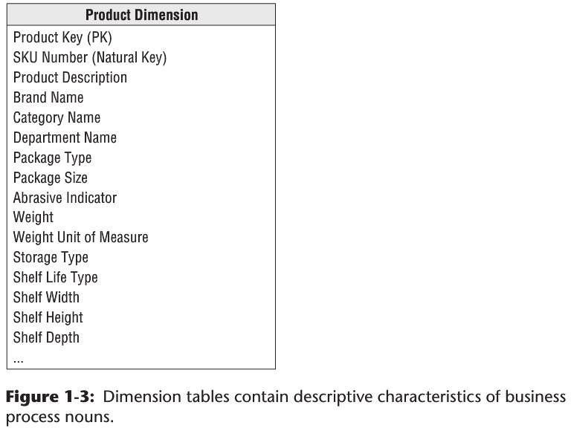
Dimension Tables for Descriptive Context (continued)

Slide 15
Dimension Tables for Descriptive Context (continued)
Figure 1-4 (see next slide) shows that dimension tables often represent hierarchical relationships. For example, products roll up into brands and then into categories. For each row in the product dimension, you should store the associated brand and category description. The hierarchical descriptive information is stored redundantly in the spirit of ease of use and query performance.
Do not normalize data by storing only the brand code in the product dimension and creating a separate brand lookup table, and likewise for the category description in a separate category lookup table.
Because typical dimension tables are geometrically smaller than fact tables, improving storage efficiency by normalizing or snowﬂaking has virtually no impact on the overall database size

Slide 16
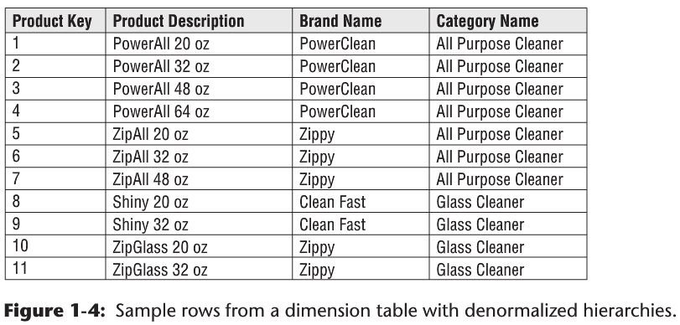
Dimension Tables for Descriptive Context (continued)

Slide 17
Facts and Dimensions Joined in a Star Schema
Each business process is represented by a dimensional model that consists of a fact table containing the event’s numeric measurements surrounded by dimension tables that contain the textual context that was true at the moment the event occurred. This characteristic star-like structure is often called a star join (see Figure 1-5 on the next slide).
The dimensional schema shown in Figure 1-5 is simple and highly recognizable to business users. It is easy to understand and navigate. Moreover, database optimizers process this simple schema with fewer joins more efficiently.

Slide 18
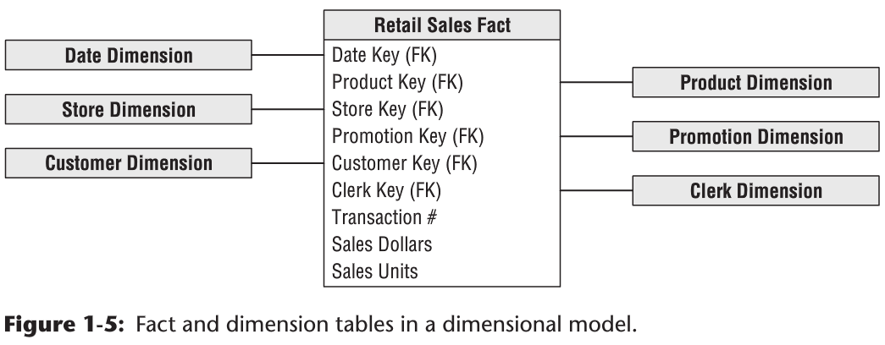
Facts and Dimensions Joined in a Star Schema (continued)

Slide 19
Facts and Dimensions Joined in a Star Schema (continued)
Atomic data that has not been aggregated is the most expressive data; this atomic data should be the foundation for every fact table design to withstand business users’ ad hoc requests in which they pose unexpected queries.
With dimensional models, we can add new dimensions to the schema as long as a single value of that dimension is deﬁned for each existing fact row.
You can supplement preexisting dimension tables with new, unanticipated attributes.
Likewise, you can add new facts to the fact table, assuming that the level of detail is consistent with the existing fact table.

Slide 20
Facts and Dimensions Joined in a Star Schema (continued)
The complementary nature of fact and dimension tables is shown when we generate a report. As illustrated in Figure 1-6 (see next slide), dimension attributes supply the report ﬁlters and labeling, whereas the fact tables supply the report’s numeric values.

Slide 21
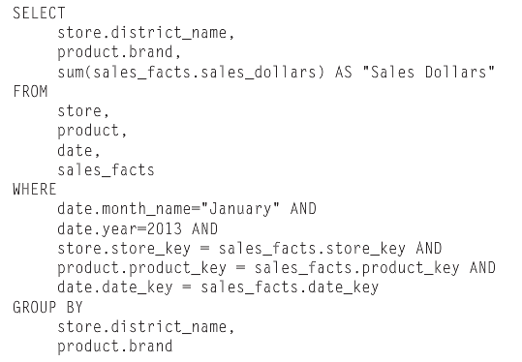
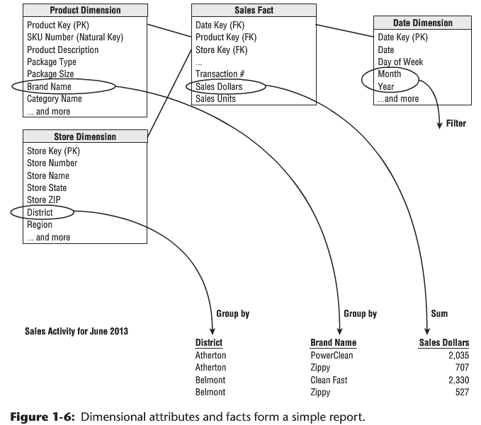
Facts and Dimensions Joined in a Star Schema (continued)

Slide 22
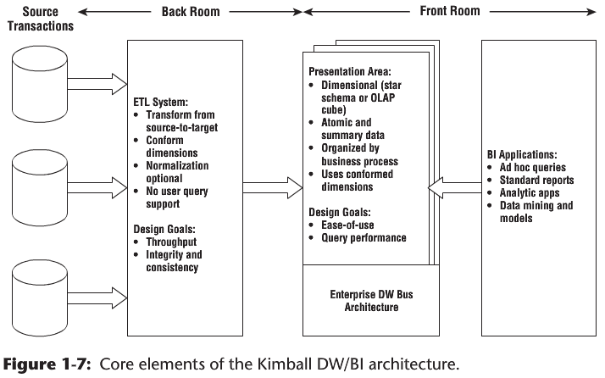
Kimball’s DW/BI Architecture

Slide 23
Kimball’s DW/BI Architecture (continued)
Operational Source Systems: these are the operational systems that capture the business’s transactions. The main priorities of the source systems are processing performance and availability. Operational queries against source systems are narrow, one-record-at-a-time queries.
Extract, Transformation, and Load (ETL) System. This part of the DW/BI architecture consists of a work area, instantiated data structures, and a set of processes.
Extraction is the ﬁrst step in the process of getting data into the data warehouse environment. Extracting means reading and understanding the source data and copying the data needed into the ETL system for further manipulation. At this point, the data belongs to the data warehouse.
After the data is extracted to the ETL system, there are numerous potential transformations, such as cleansing the data (correcting misspellings, resolving domain conﬂicts, dealing with missing elements, or parsing into standard formats), combining data from multiple sources, and de-duplicating data. The ETL system adds value to the data with these cleansing and conforming tasks by changing the data and enhancing it.
The ﬁnal step of the ETL process is the physical structuring and loading of data into the presentation area’s target dimensional models.

Slide 24
Kimball’s DW/BI Architecture (continued)
Presentation Area to Support Business Intelligence. The DW/BI presentation area is where data is organized, stored, and made available for direct querying by users, report writers, and other analytical BI applications.
The data in the presentation area should be presented, stored, and accessed in dimensional (instead of in normalized) schemas, either relational star schemas or OLAP cubes.
the presentation area must contain detailed, atomic data. Although the presentation area may contain performance-enhancing aggregated data, it is unacceptable to store only summary data in dimensional models while the atomic data is locked up in normalized models.

Slide 25
Kimball’s DW/BI Architecture (continued)
Business Intelligence Applications. The ﬁnal major component of the Kimball DW/BI architecture is the business intelligence (BI) application. The term BI application loosely refers to the range of capabilities provided to business users to leverage the presentation area for analytic decision making.
A BI application can be as simple as an ad hoc query tool or as complex as a sophisticated data mining or modeling application.
Ad hoc query tools, as powerful as they are, can be understood and used effectively by only a small percentage of the potential DW/BI business user population.
Most business users will likely access the data via prebuilt parameter-driven applications and templates that do not require users to construct queries directly.

Slide 26
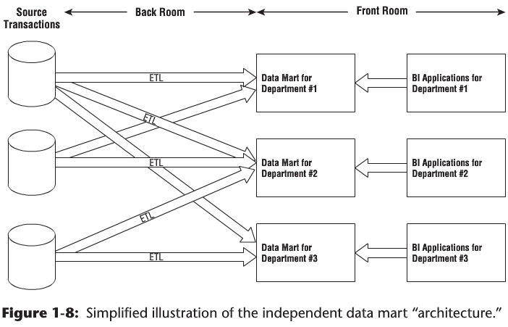
Alternative DW/BI Architectures

Slide 27
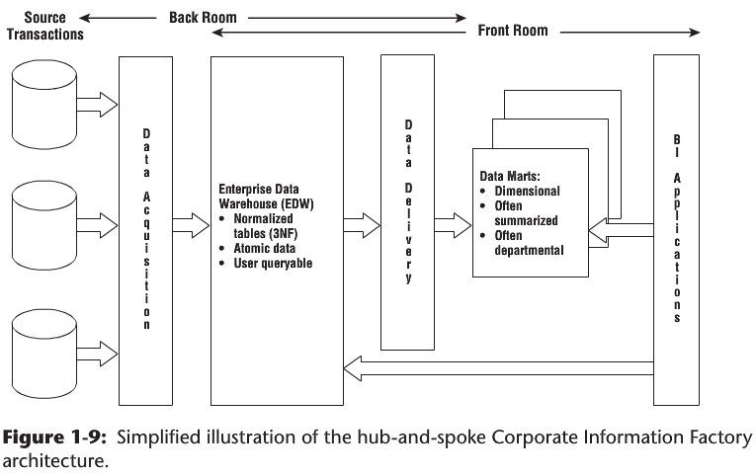
Alternative DW/BI Architectures (continued)

Slide 28
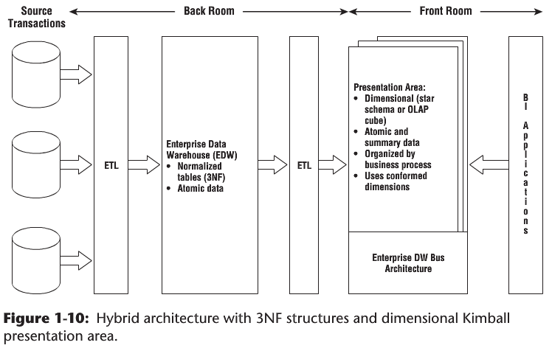
Alternative DW/BI Architectures (continued)

Slide 29
Dimensional Modeling Myths
Myth 1: Dimensional Models are Only for Summary Data.
This myth is frequently the root cause of ill-designed dimensional models. Because you cannot possibly predict all the questions asked by business users, you need to provide them with query-able access to the most detailed data so they can roll it up based on the business question. Data at the lowest level of detail is practically impervious to surprises or changes.
Summary data should complement the granular detail solely to provide improved performance for common queries, but not replace the details.
Myth 2: Dimensional Models are Departmental, Not Enterprise
Rather than drawing boundaries based on organizational departments, dimensional models should be organized around business processes, such as orders, invoices, and service calls. Multiple business functions often want to analyze the same metrics resulting from a single business process.

Slide 30
Dimensional Modeling Myths (continued)
Myth 3: Dimensional Models are Not Scalable
Dimensional models are extremely scalable. Fact tables frequently have billions of rows; fact tables containing 2 trillion rows have been reported. The database vendors have wholeheartedly embraced DW/BI and continue to incorporate capabilities into their products to optimize dimensional models’ scalability and performance.
Myth 4: Dimensional Models are Only for Predictable Usage
Dimensional models should not be designed by focusing on predeﬁned reports or analyses; the design should center on measurement processes. It is important to consider the BI application’s ﬁltering and labeling requirements; but, we should not design for a top ten list of reports in a vacuum because this list is bound to change, making the dimensional model a moving target. The key is to focus on the organization’s measurement events that are typically stable, unlike analyses that are constantly evolving.

Slide 31
Dimensional Modeling Myths (continued)
Myth 5: Dimensional Models Can’t Be Integrated
Dimensional models most certainly can be integrated if they conform to the enterprise data warehouse bus architecture. Conformed dimensions are built and maintained as centralized, persistent master data in the ETL system and then reused across dimensional models to enable data integration and ensure semantic consistency.
Data integration depends on standardized labels, values, and deﬁnitions. It is hard work to reach organizational consensus and then implement the corresponding ETL rules, but we can’t dodge the effort.

Slide 32
Summary
In this chapter we discussed the overriding goals for DW/BI systems and the fundamental concepts of dimensional modeling.
The Kimball DW/BI architecture and several alternatives were compared.
We closed out the chapter by identifying common misunderstandings that some still hold about dimensional modeling.

